Slide 1
Lecture 9

Slide 2
Question
A sound wave travels down a pipe. When it reaches the end what will happen?
The wave will keep going into the air in the room
The wave will stop at the end of the pipe and reflect back.
Some of the energy in the wave will keep going into the room air, and some will reflect back.
The pipe will explode

Slide 3
Question
A sound wave travels down a pipe. When it reaches the end of the pipe, Some of the energy in the wave will keep going into the room air, and some will reflect back. How does it reflect back?

Slide 5
Some reflect back
Some Keep Going

Slide 6
Question 223.7.1
A pipe, closed at one end, has a displacement node at one end. Why?
The pressure there must match atmospheric pressure
The molecules experience a 3rd law reaction force
The end prevents the molecules from moving in a longitudinal direction

Slide 7
Question 223.7.2
A pipe that is open at both ends has a standing sound wave generated in it. The pipe will have a pressure ____________ at both ends.
Node
Antinode
Neither

Slide 8
Question 223.7.2.5
A pipe, open on both ends has a tuning fork next to it which is oscillating at the pipe’s second harmonic frequency, How big is the wavelength compared to the pipe length?
λ = L/2
λ = L
λ = 2L
λ = (3/2)L

Slide 9
L
Displacement from Equilibrium
Pressure Change

Slide 10
L

Slide 11
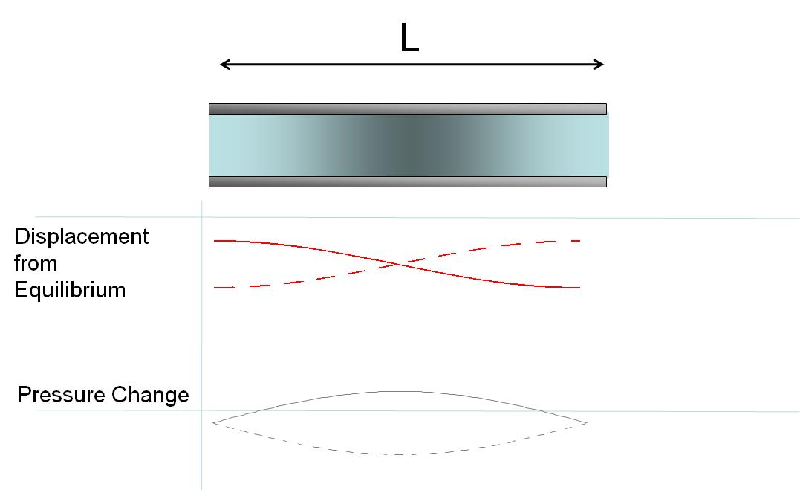
L
Displacement from Equilibrium
Pressure Change

Slide 12
L

Slide 13
Question 223.7.2.6
A pipe, open on both ends has a tuning fork next to it which is oscillating at the pipe’s second harmonic frequency. The pipe is 30cm long? The speed of sound is 343m/s. What is the frequency we will hear?
286Hz
572Hz
1143Hz
1715Hz
2287Hz

Slide 14
Question 223.7.2.7
A pipe, closed on one end has a tuning fork next to it which is oscillating at the pipe’s second harmonic frequency, How big is the wavelength compared to the pipe length?
286Hz
572Hz
1143Hz
1715Hz
2287Hz

Slide 15
Question 223.7.4
You have designed a support structure, but you find you have a device placed on the structure that excites a longitudinal natural frequency of a support strut. To dampen this effect you could
Clamp the strut at a non resonant point
Apply glue to the end where the struts fastens
Add a device that superposes another frequency on the strut
Can’t tell

Slide 16
Question 223.7.5
Suppose you have designed a large telescope with a whopping 6m diameter primary mirror. The telescope will be mounted on a motorized platform. Should you be concerned about vibration ruining your imagery?
No, the curved circular shape of the mirror precludes any longitudinal or transverse waves.
Yes there are normal modes of oscillation in any structure
No. the motor will produce longitudinal waves, such as a long thin structure like a rod can support.

Slide 17
Clamped Rod
The clamp prevents movement here
Atoms can move longitudinally here
Atoms can move longitudinally here

Slide 18
Clamped Rod: Center Clamp

Slide 19
Clamped Rod
The clamp prevents movement here
Atoms can move longitudinally here
Atoms can move longitudinally here

Slide 20
Clamped Rod: L/4 Clamp

Slide 21
Drum Head

Slide 22
Question 223.7.3
Sound that produces standing wave frequencies that are not related by integer multiples is called
Atonal
Noise
Circle of 5ths
Guns n Roses
Can’t tell

Slide 23
A flash from a light bulb gets the wave started
Reflected wave is inverted and forms a standing wave
Mirrors

Slide 24
Partial mirror that lets some light out
Amplifier
Mirrors

Slide 26
End

Slide 27
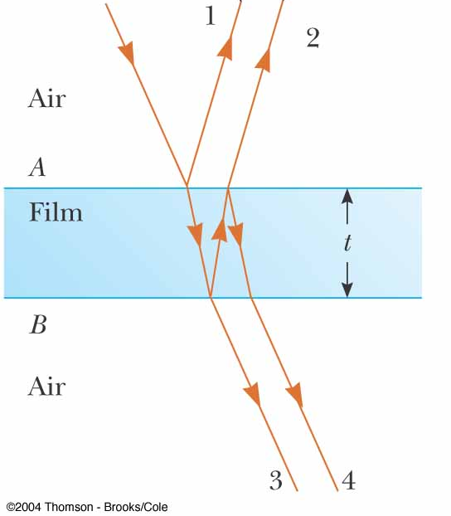
Question 223.8.1
In the figure, will rays 1 and 2 be in phase?
Yes
No
Can’t tell with the information given

Slide 28
Question 223.8.2
The thickness of the film is 2 wavelengths. The film has a refractive index that is bigger than 1. Will rays 1 and 2 be in phase?
Yes
No
Can’t tell with the information given

Slide 29
Question 223.8.2.5
The thickness of the film is 2 wavelengths. The film has a refractive index that is bigger than 1. Will rays 3 and 4 be in phase?
Yes
No
Can’t tell with the information given

Slide 30
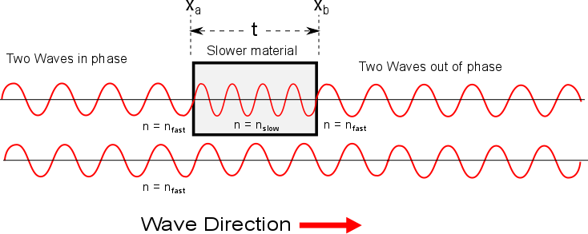

Slide 31
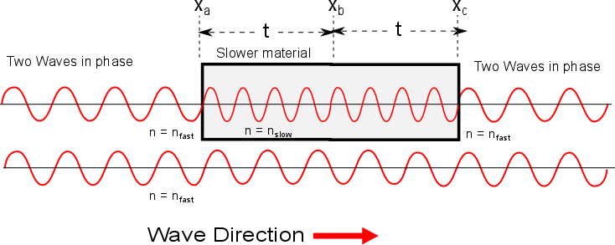

Slide 32
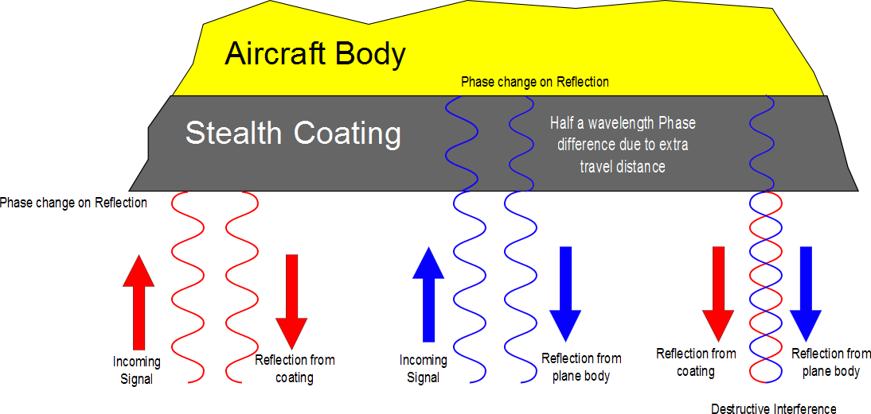

Slide 33
Loud Spot

Slide 34
Loud Spot
Full wavelength farther from the green wave center

Slide 35
Loud Spots

Slide 36
Dead Spot
Half a wavelength farther from the green wave center

Slide 37
Dead Spots

Slide 38
Question 223.8.3
I have two waves coming from speakers in my room. I am sitting 3 wavelengths away from one speaker and 4.5 wavelengths away from the other speaker. I hear..
Twice the normal loudness
4 times the normal loudness
8 times the normal loudness
Practically nothing

Slide 39
Question 223.8.4
I have two waves coming from speakers in my room. I am sitting 3 wavelengths away from one speaker and 6 wavelengths away from the other speaker. I hear..
Twice the normal loudness
4 times the normal loudness
8 times the normal loudness
Practically nothing

Slide 40
3m
2m
2m

Slide 41
Example of Beats

Slide 43
Question 223.9.1
Two graphs are shown below. Each graph represents the result of adding two waves together. For which graph is the frequency difference greater between the two original waves?.
A
B

Slide 44
Question 223.9.2
You are tuning a guitar by comparing the sound of the string with that of a standard tuning fork. You notice a beat frequency of 5Hz. You tighten the guitar string and the beat frequency rises to 8Hz. In order to tune the string exactly to the tuning fork, you should
Continue to tighten the string
Loosen the string
Impossible to determine

Slide 45
Flour
Sugar
Eggs
Chocolate Chip Cookies
Chocolate Chips
Baking Powder
Margarine
vanilla

Slide 46
Flour
Sugar
vinegar
Chocolate cake
cocoa
Baking Soda
oil
vanilla

Slide 47
Chocolate Chip Cookies
Mass of ingredient
Flour
Sugar
Eggs
Margarine
Vanilla
Chocolate Chips
Baking Powder

Slide 48
440Hz
880Hz
1320Hz
Trumpet A
1760Hz
2200Hz
2640Hz
3080Hz

Slide 49
440Hz
1320Hz
Clarinet A
2200Hz
3080Hz

Slide 50
Trumpet A
Amplitude of Partial
440Hz
880Hz
1320Hz
2640
3080
1760Hz
2200Hz

Slide 51
Clarinet A
Amplitude of Partial
440Hz
880Hz
1320Hz
2640
3080
1760Hz
2200Hz

Slide 54
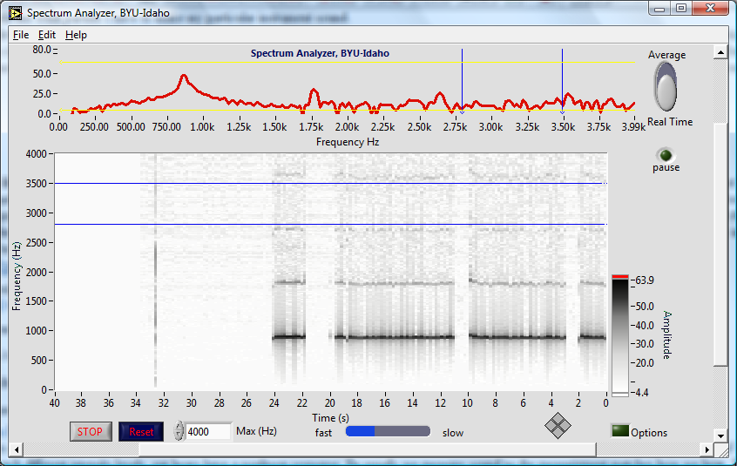
Peaks show partials

Slide 55
Strip chart also shows partials, darker black means higher peak
It is like looking at the graph above, but from above, and repeated for each second of playing

Slide 56
Notice that there are non-harmonic partials in this instrument too!

Slide 57
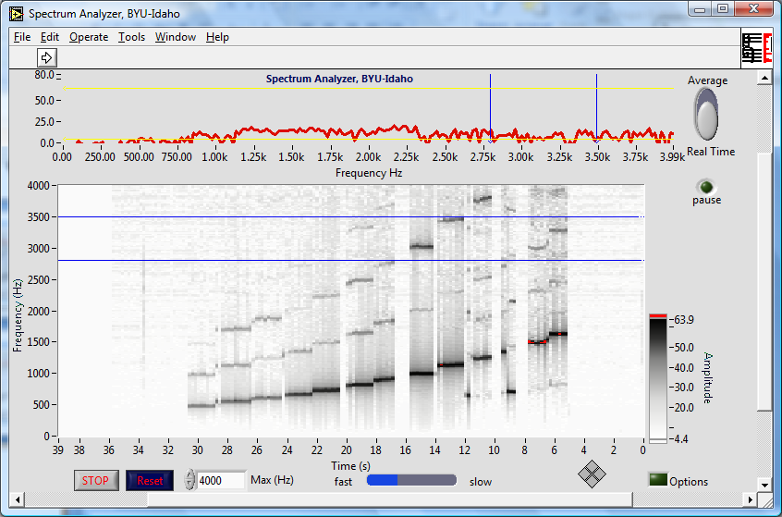
Bamboo six holed flute

Slide 58
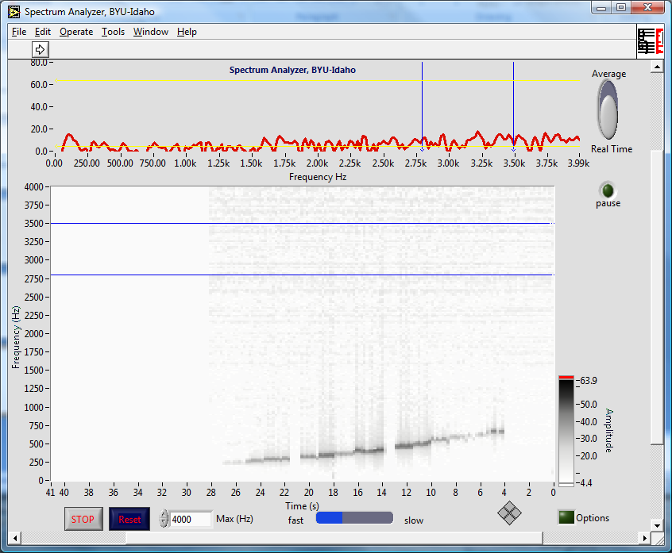
Ocarina

Slide 59
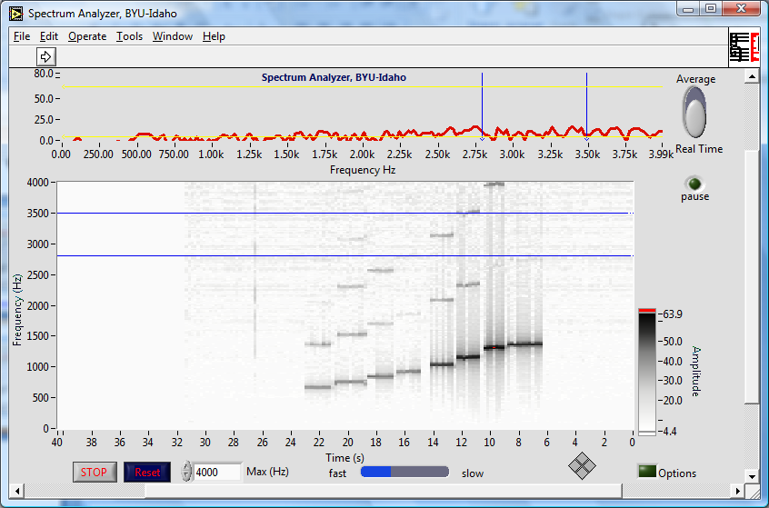
Recorder

Slide 60
Recorder

Slide 61
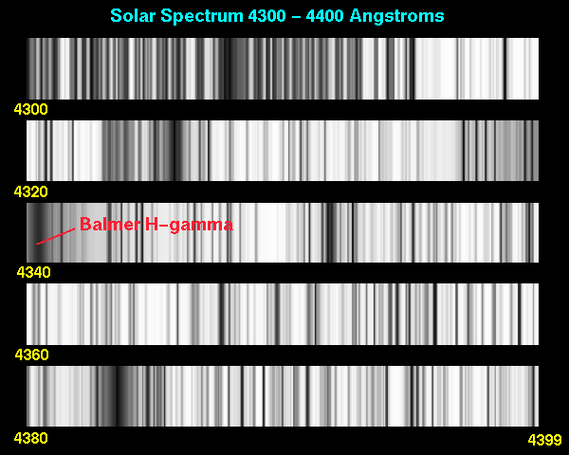
Application: Light Spectra

Slide 62


Slide 63
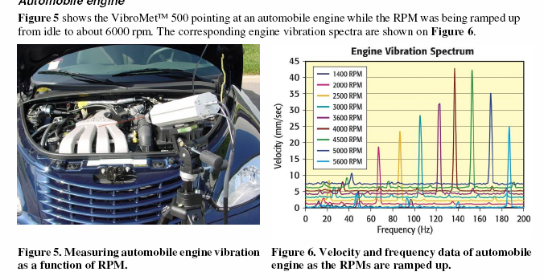
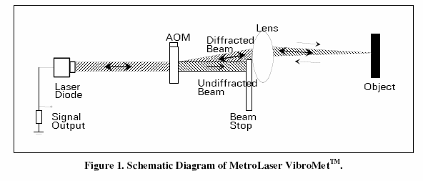
Application: Industrial Monitoring

Slide 64
Application, Vibrometry Target ID

Slide 65
Example: Square Wave

Slide 66
Example: Square Wave

Slide 67
Example: Square Wave, More Terms

Slide 68
Example: Square Wave

